Slide 1

Sales Induction
Knowledgeable Employees. The first benefit of a well-designed retail training program is it helps develop a knowledgeable workforce
Greater Efficiency, Productivity & Performance
Better Customer Service
Increased Sales
Improved Employee Retention

Slide 2
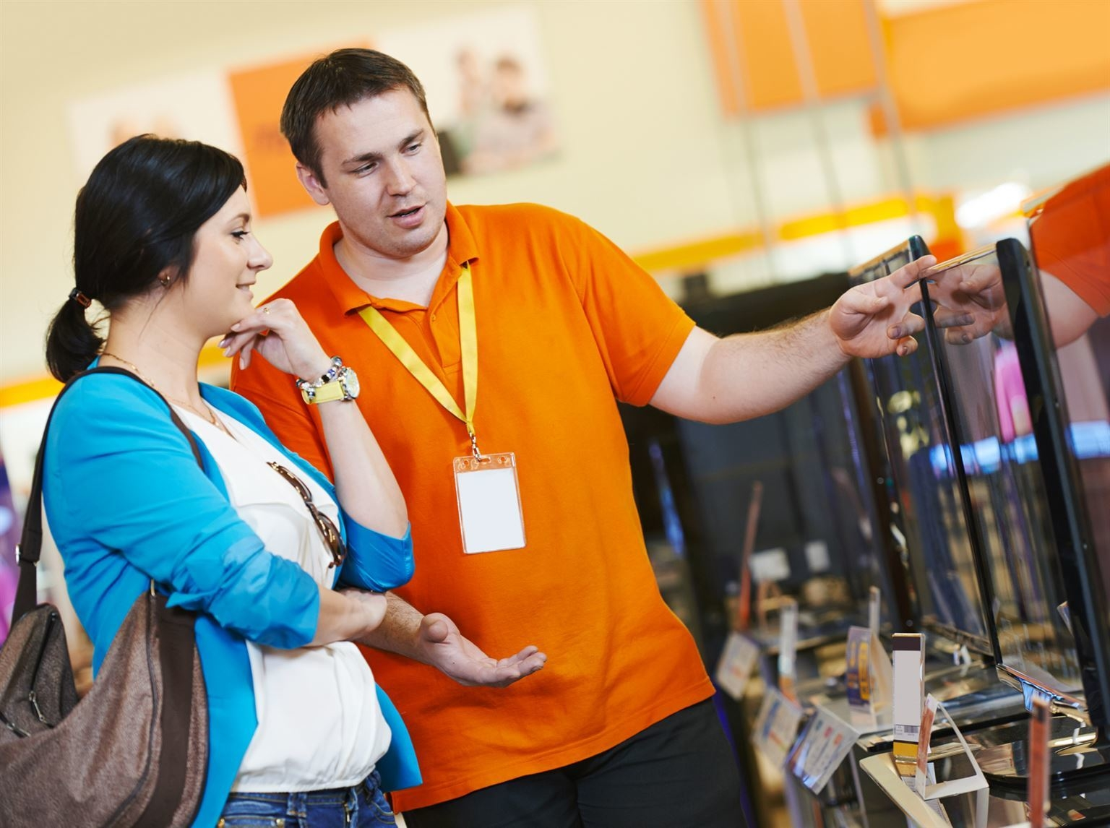
What is the meaning of retail sales? Retail sales is the sale of consumer goods, or final goods, by businesses to end consumers, and includes in-store sales as well as online sales. Products may be durable (with a significant expected shelf life) or perishable (such as groceries). Food, clothing and furniture are some broad examples of consumer goods.
---------
---------
The Basic Retail Price Formula
Retail Price = Cost of Goods + Markup.
Markup = Retail Price – Cost of Goods.
Cost of Goods = Retail Price – Markup.
sales" refers to all activities involved in selling a product or service to a consumer or business.

Slide 3
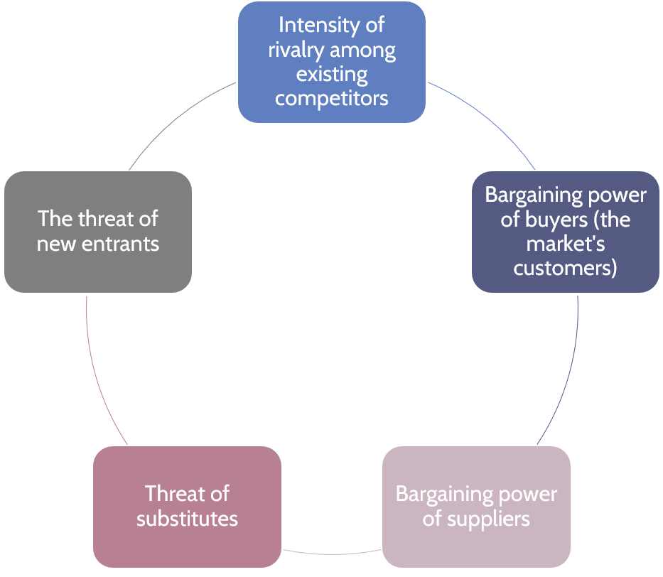
Suppliers
Stages or phases of Wheel of Retailing
The picture illustrates the stakeholder or the structure of retail business.
Community and the culture dictates choice and preference
Customers –types of customers and age group contemporary and fashion customer
Suppliers-Supply chain from factory to warehouse to store
Competitors-What Is a Competitor Analysis?
A competitor analysis is the process of identifying your competitors and researching their strengths, weaknesses, products, and marketing strategies to identify potential opportunities for your own business. It helps in understanding the market landscape and making informed decisions to improve your position in the industry
community
Customers
competitor

Slide 4
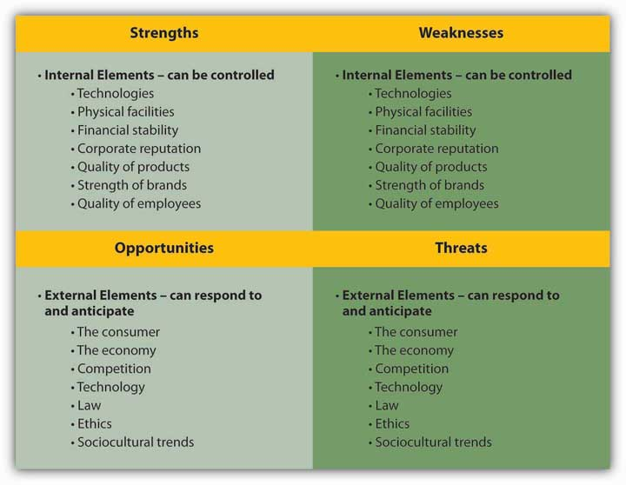
basic ways to analyse competitors
Understand your industry and competitive landscape
Find different types of competitors
Understand your market and audience
Use your findings to create benchmarks
Evaluate your current marketing strategy (and even develop a new one)

Slide 5
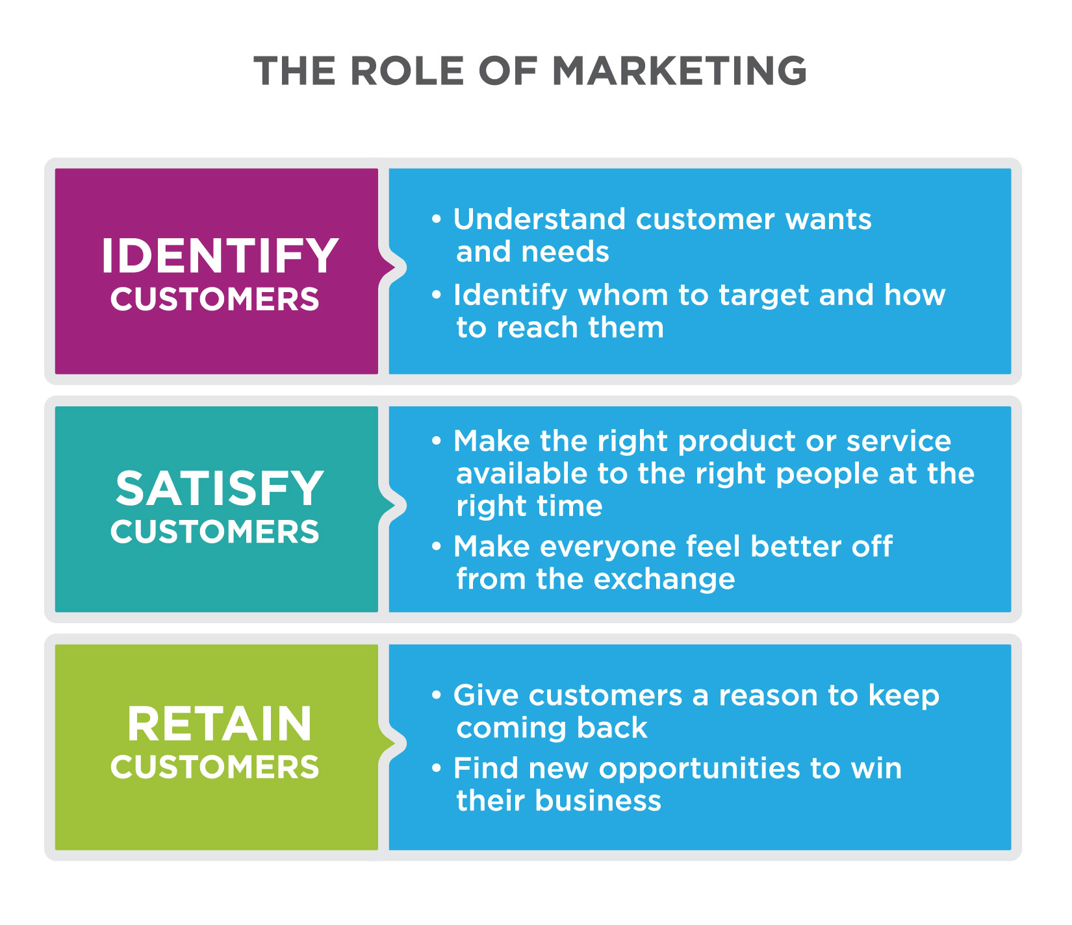
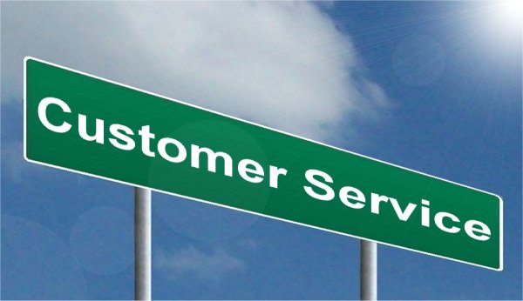
Customer service
Key Elements of Good Customer Service
Put customer needs first.
Clarify the customer's goals and roadblocks.
Prioritize quality over quantity.
Engage customers with genuine interest and enthusiasm.
Create accessible, omnichannel support options.
Troubleshoot collaboratively.
Ask for feedback and learn from customers.
Solve for long-term solutions, rather than short-term conveniences.

Slide 6
Types of customers in retail fashion
What is classic in fashion?
Classic clothing style describes a person's personality of preference towards timeless looks, simple and elegant cuts, choice of fine natural fabrics, and matching accessories such as leather shoes and handbags. Though not giving a flashiest look in the room, classic clothing choice always make a person look good.
What is contemporary fashion? Contemporary fashion stands for high-quality modern clothing and accessories that are currently on-trend, which are also accessible and attainable. Some brands and designers also focus on the environmental factor.

Slide 7
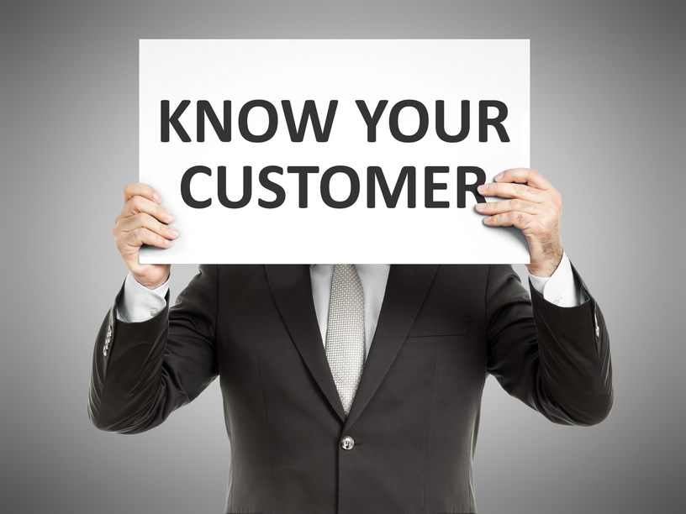
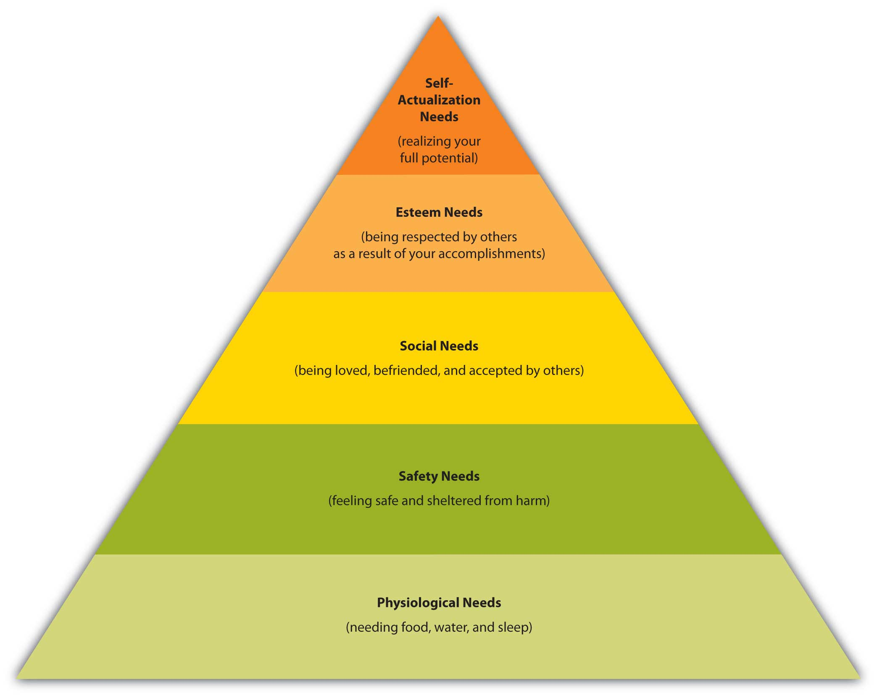

Slide 8
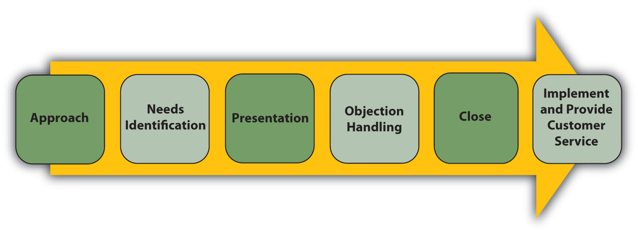
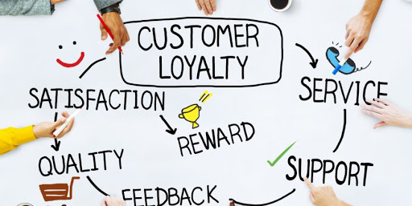

Slide 9
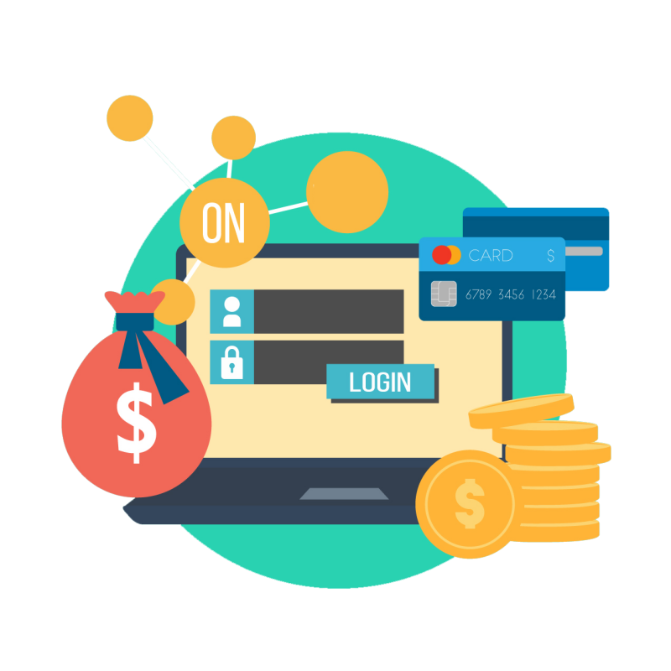
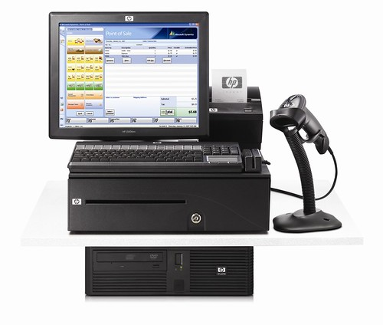
Point of sales and mode of payment
-Point of sale is not only used for sales but inventory too
-We have different mode of payment commonly used is Cash credit Debit & Gift cards

Slide 10
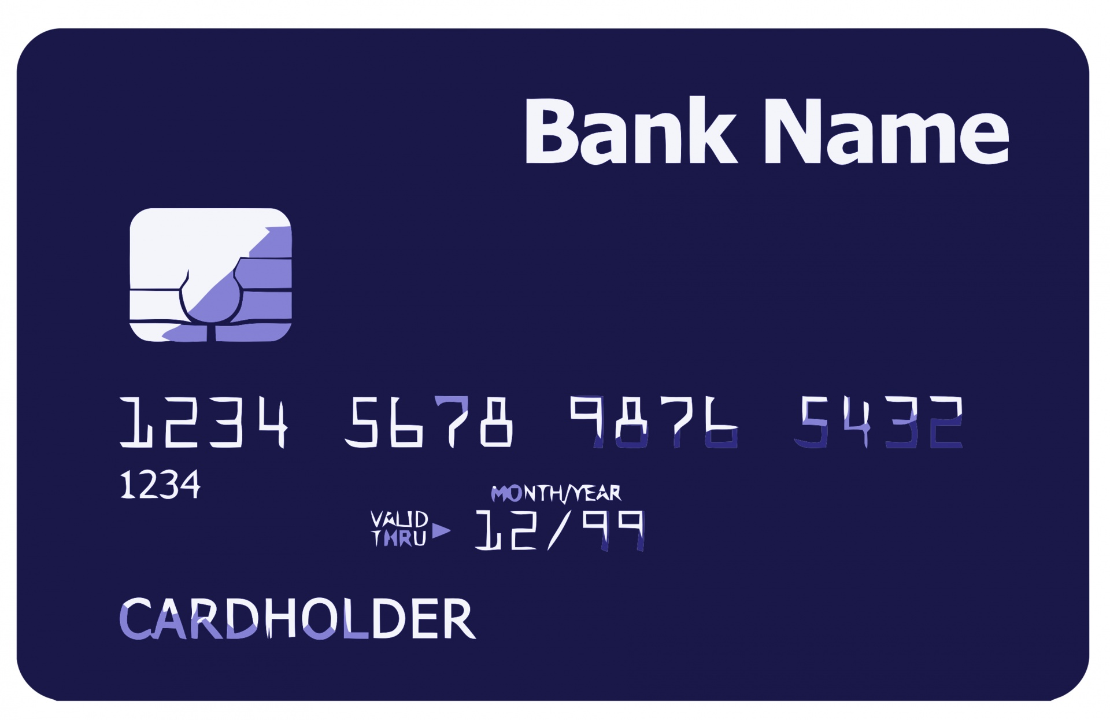
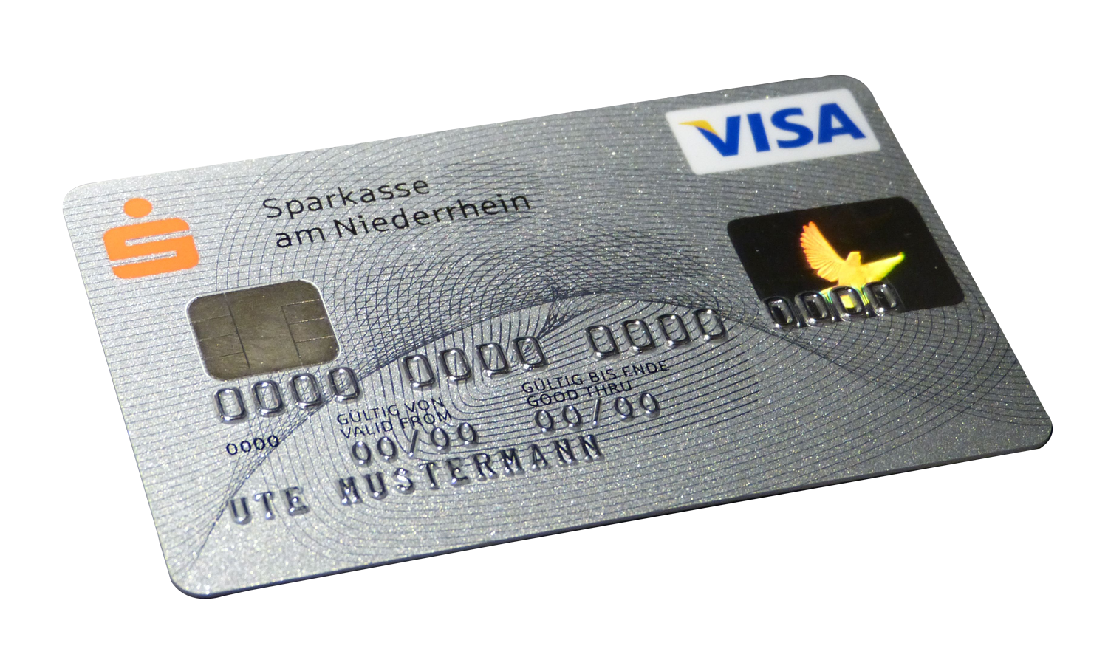
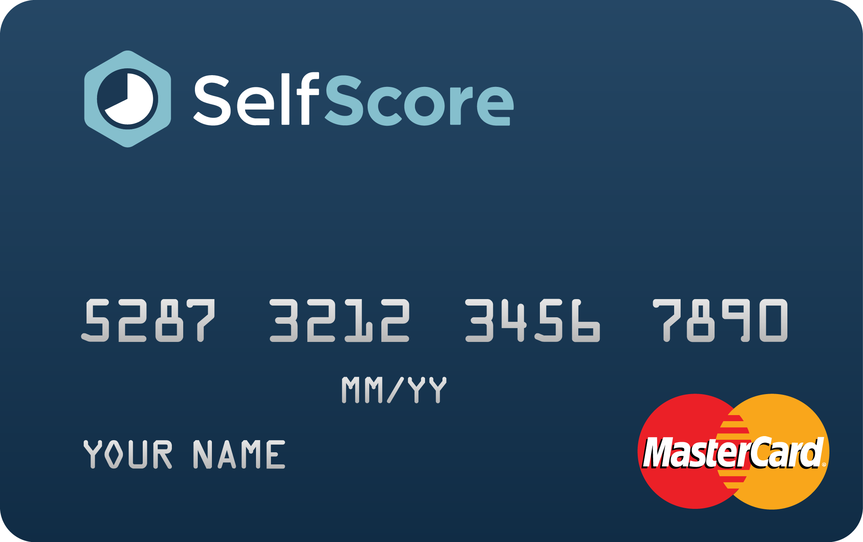
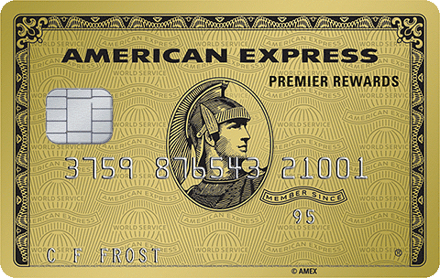
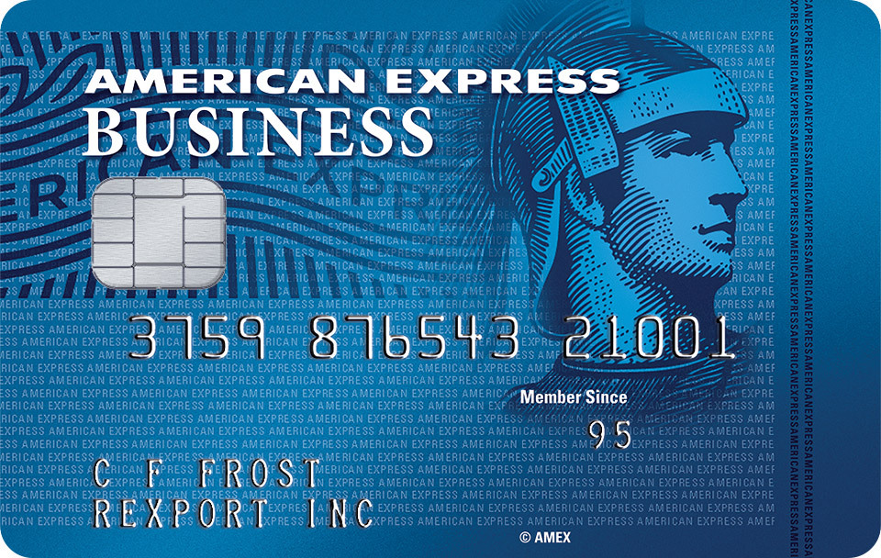
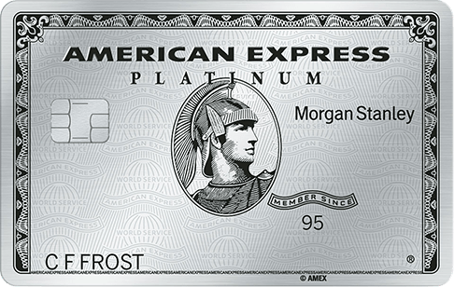
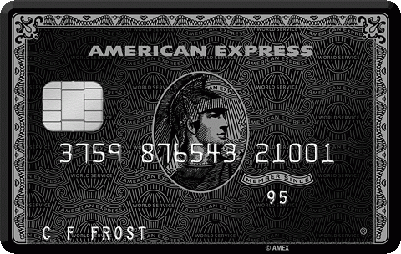
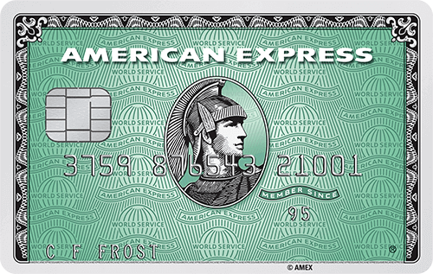
Types of credit Cards

Slide 11
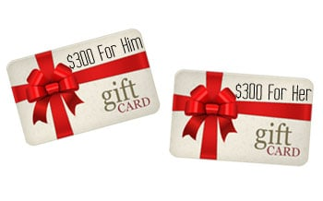
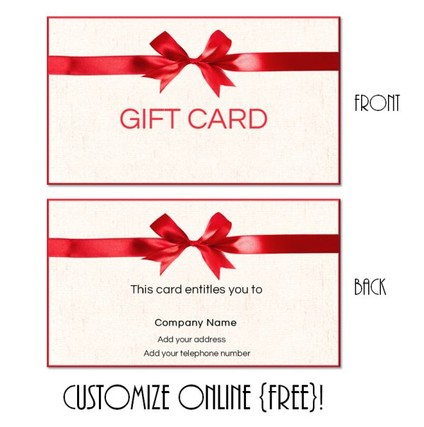
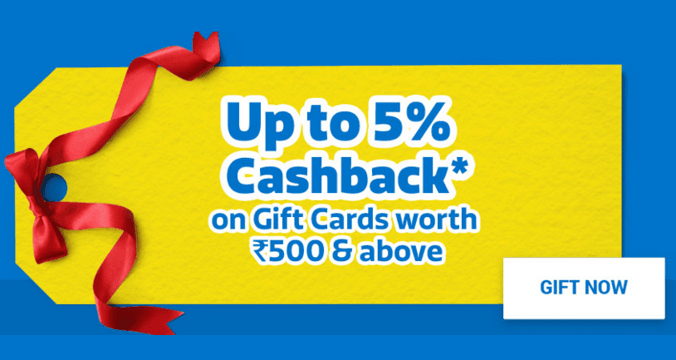
Gift Cards as one mode of payment

Slide 12
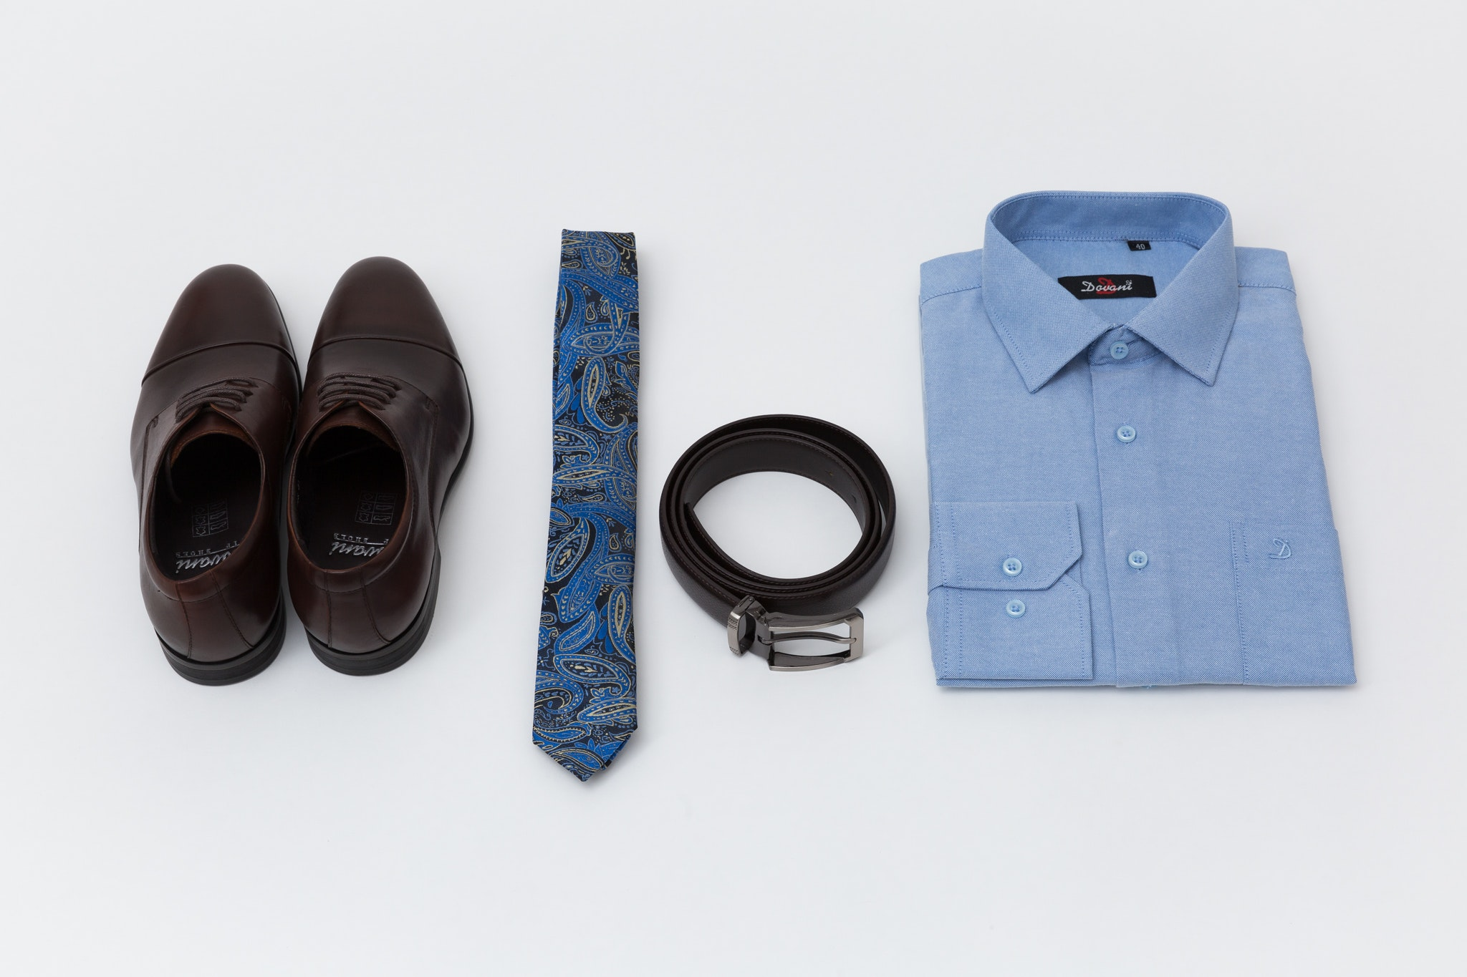
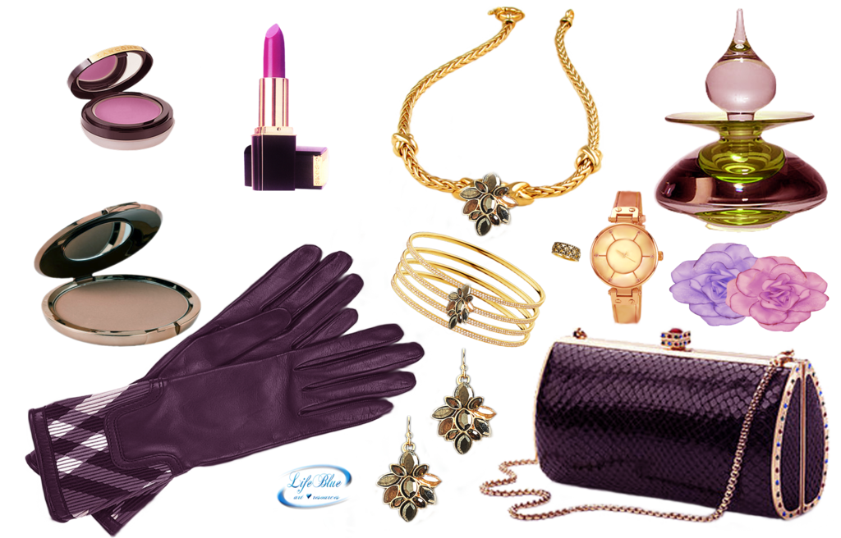
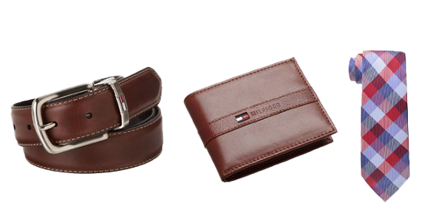
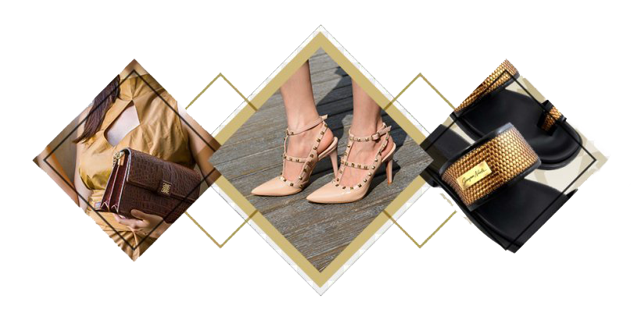
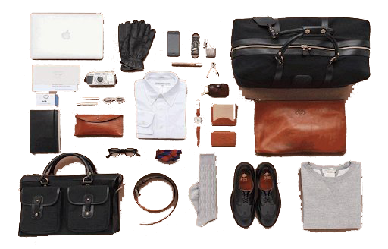
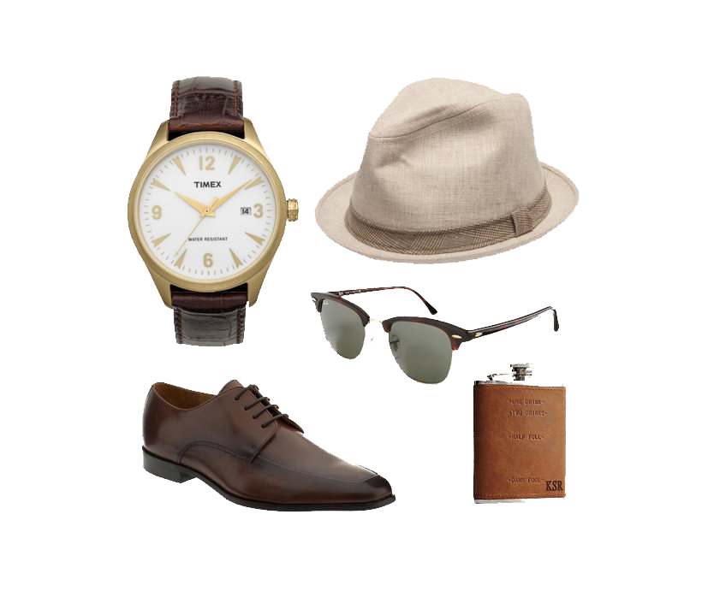
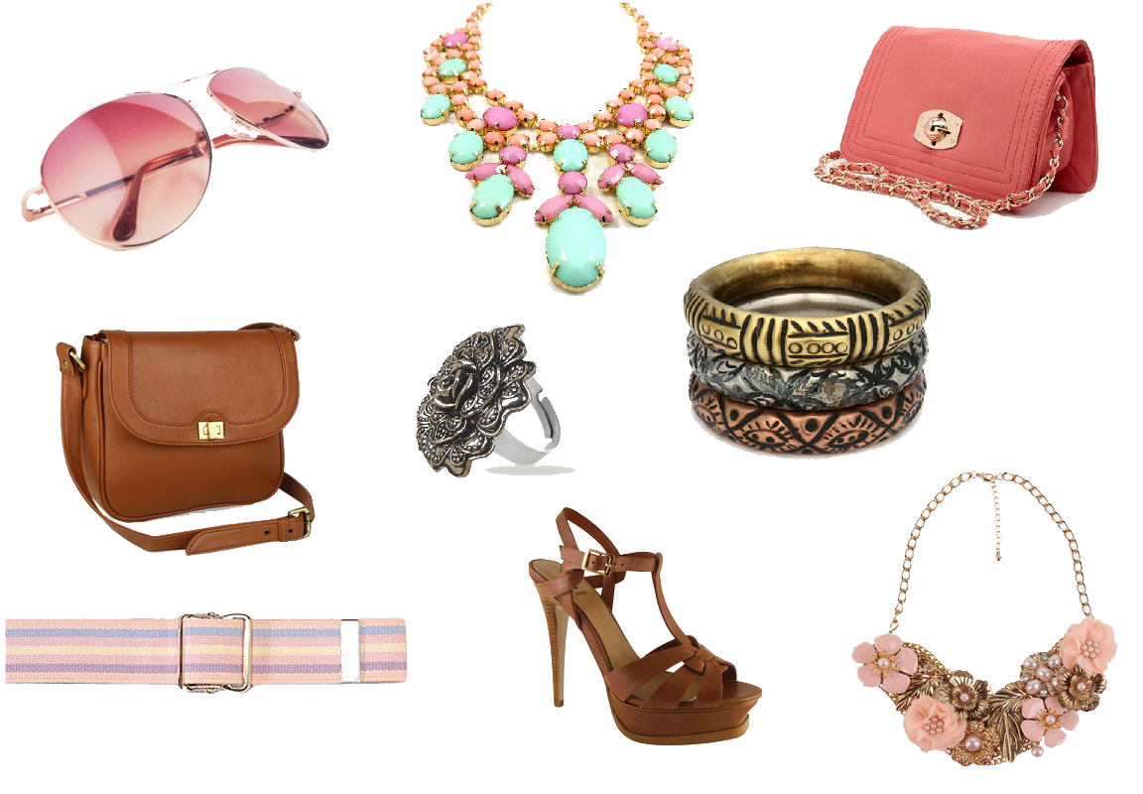
Additional sales
What is an example of an add-on sale?
Add-on sales are additional products or services that complement a customer's main purchase. For example, a sales associate could suggest Ties, Hand bag ,Wallet accessories as an add-on sale to someone buying a shirt or a dress

Slide 13
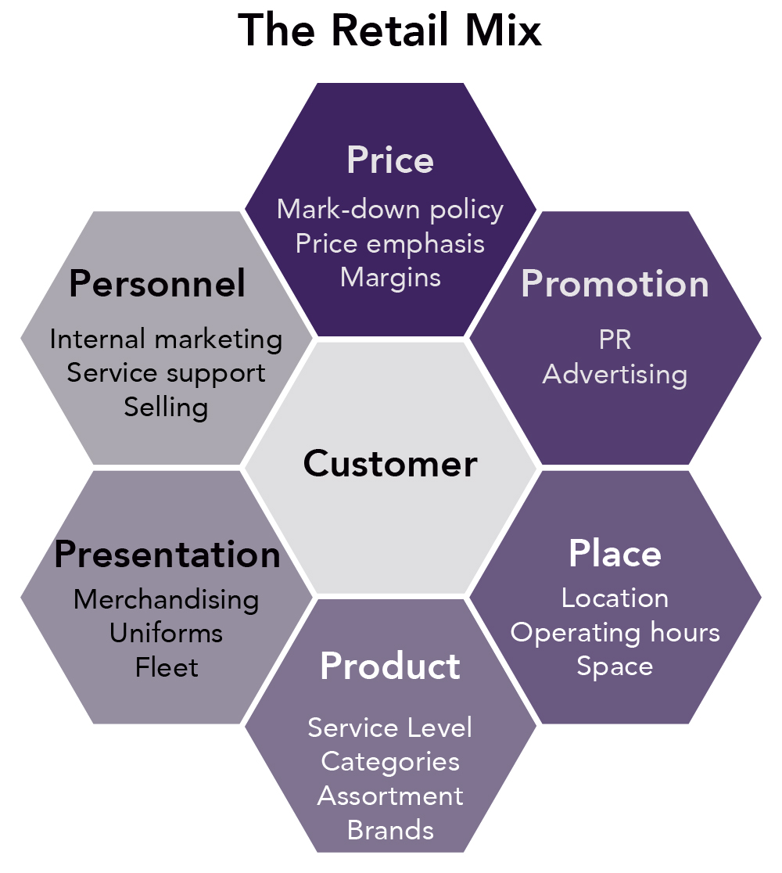
First Impression
Ask Questions. One of the keys to making a good first impression is to show genuine interest in any potential customer. This means using a consultative selling process and asking meaningful, intelligent questions.
Asking open ended question to know customers requirement.
Keep eye contact
Greeting your customer upon entering your store
Grabbing the opportunity after noticing interest
Store Merchandising standards
This Photo by Unknown Author is licensed under CC BY-SA

Slide 14
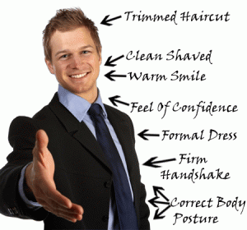
Lasting Impression
Finally, the best way to create a lasting impression is to be yourself. Be authentic, honest, and respectful in your communication. Show your personality, passion, and enthusiasm for your product or service. Be friendly, courteous, and polite in your interactions. Be humble, grateful, and appreciative for your customers' business. Be consistent, reliable, and dependable in your service. By being yourself, you can build rapport, trust, and loyalty with your customers.
Calling customers by their names makes the customer feel important and taking record of their contacts and informing them on events sale promotions or new arrivals this does not only increase your sales but they become frequent customers and choses you against your competitors

Slide 15
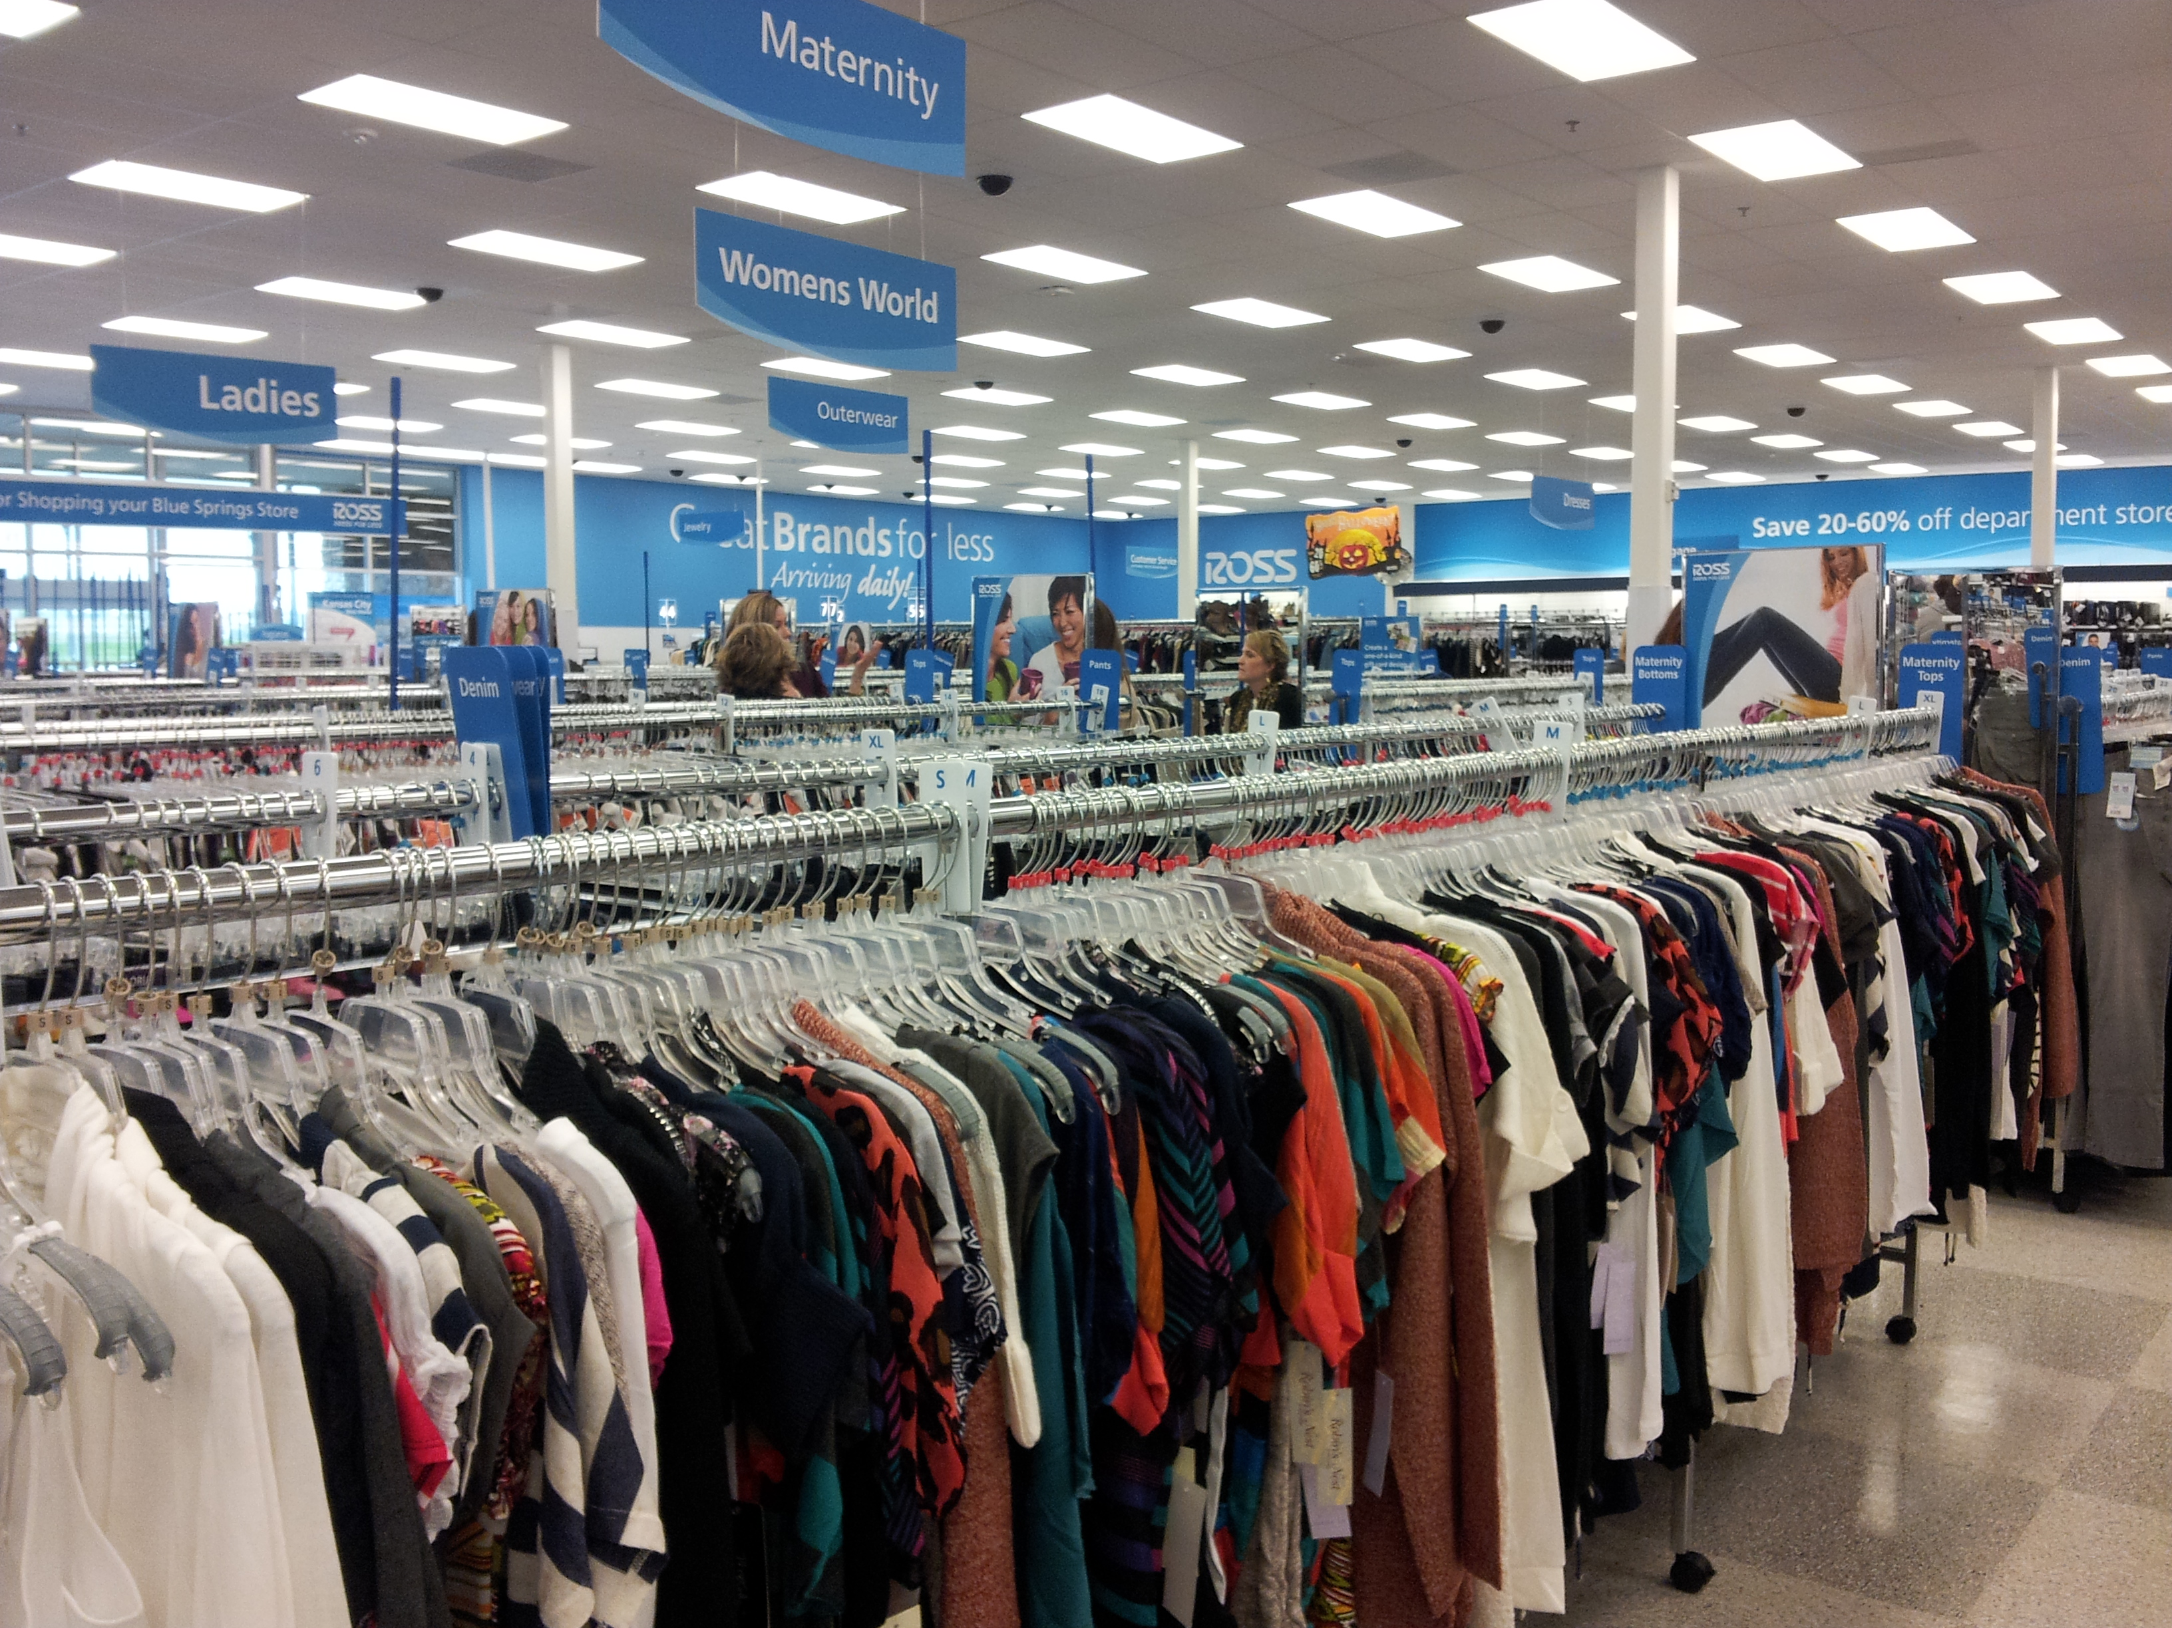
CUSTOMER SERVICE providing assistance and support to customers before, during, and after the purchase of a product or service.
----------------
In order to identify and understand customer needs better, businesses should ask the classical open ended questions, which are asked by anyone who wishes to get information: why, what, how, when and where. First, businesses need to know why the customers intend to buy what they are buying.
Most customers have a set of 7 basic needs
Friendliness. This is the most basic customer need that's associated with things like courtesy and politeness.
Empathy. Customers need to know the organization understands and appreciates their needs and circumstances
Fairness. Customers must feel that they’re getting adequate attention and fair and reasonable answers.
Control. Customers want to feel like they have an influence on the outcome.
Alternatives. You offer alternative when customer doesn’t get the exact items
Information. You offer genuine information on product offers and prices
Time. Most appreciate when their time is saved while serving them

Slide 16
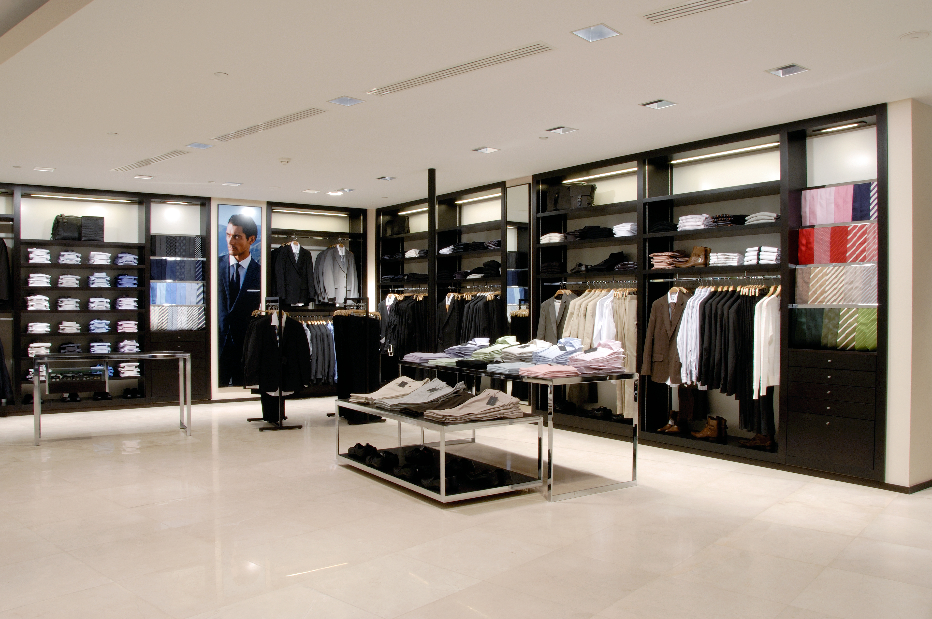
Here are a few examples of customer needs:
--------
Fast, reliable customer service
Convenient ways to get help, such as through messaging channels
Options for getting in touch with customer support
A knowledge base that enables customers to solve issues on their own, 24/7
Friendly, empathetic agents
Sustainable products and socially conscious brands
Seamless returns
Transparent pricing
Functional products that solve a problem
The right information, at the right time

Slide 17
Role of window and store merchandising in Retail fashion
What is the role of merchandising in retail?
Your role as a retail merchandiser is to ensure that products appear in the right store or website, at the right time and in the right quantities. This involves working closely with buying teams to accurately forecast trends, plan stock levels and monitor performance.

Slide 18
Merchandising In Store Merchandising
--------
What is the importance of merchandising in a store?
Merchandising makes several important contributions to your store. It increases sales by making a store appealing to your customers. It improves profitability by generating more margin dollars. It controls costs by improving the productivity of the salesfloor as well as each employee.

Slide 19
Thbadbess tutorial

